Slide 1
Crop Science
Lecture 6
09th September 2021
STRESS PHYSIOLOGY

Slide 2
Stress Physiology
Plants are frequently exposed to environmental stresses
Some environmental factors, such as air temperature, can become stressful in just a few minutes;
Soil water content, may take days to weeks
Soil mineral deficiencies can take months to become stressful
Stress resulting from climatic and soil conditions (abiotic factors) result in reduced yield of field grown crops
Stress plays a major role in determining how soil and climate limit the distribution of plant species

Slide 3
Stress
Stress is defined as an external factor that exerts a disadvantageous influence on the plant
Stress is measured in relation to plant survival
Crop yield
Growth
The concept of stress is intimately associated with that of stress tolerance, which is the plant’s fitness to cope with an unfavorable environment
Adaptation to environmental stresses result from integrated events occurring at all levels of organization, from the anatomical and morphological level to the cellular, biochemical
Notes:
For example, the wilting of leaves in response to water deficit reduces both water loss from the leaf and exposure to incident light, thereby reducing heat stress on leaves

Slide 4
Water stress
Water deficit can be defined as any water content of a tissue or cell that is below the highest water content exhibited at the most hydrated state
Typically, as the water content of the plant decreases, its cells shrink and the cell walls relax
Because turgor reduction is the earliest significant biophysical effect of water stress, turgor-dependent activities such as leaf expansion and root elongation are the most sensitive to water deficits

Slide 5
Response to water stress
When plants become water stressed after a substantial leaf area has developed, leaves will senesce and eventually fall off
Such a leaf area adjustment is an important long-term change that improves the plant’s fitness in a water-limited environment
Abscission during water stress results largely from enhanced synthesis of and responsiveness to the endogenous plant hormone ethylene

Slide 6
Water deficit enhances root extension into deeper moist soil
Mild water deficits also affect the development of the root system
Root-to-shoot biomass ratio appears to be governed by a functional balance between water uptake by the root and photosynthesis by the shoot

Slide 7
Partial water stress
Mild water stress affects both leaf photosynthesis and stomatal conductance
Water Deficit Increases Wax Deposition on the Leaf Surface
A developmental response to water stress is the production of a thicker cuticle that reduces water loss from the epidermis
Changes in leaf size and leaf orientation are very effective in conserving water than Maintaining a leaf temperature that is much lower than the air temperature that requires evaporation of vast quantities of water

Slide 8
Water stress adaptation
Water stress adaptation may be achieved by improved plant uptake of water from soil
Reduced loss of water by plants
High plant water-conducting capacity
High plant storage of water

Slide 9
Stress adaptation
Reduction in water transpiration could help conserve available water inside plants
Moderated water use through reduced leaf area and shorter growth duration
Ability of roots to exploit deep soil moisture to provide for evapotranspiration demands

Slide 10
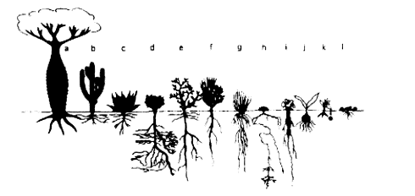
Notes:
FIGURE 7.5. Modifications in plant shoot and root morphology to survive drought, a = deciduous bottle trees with water storing trunks (Adansonial Chorisia type); b = succulents storing water in the stem (Cacti/Euphorbia type); c = succulents with water storing leaves (Agave/Crassulaceae type); d = evergreen trees and shrubs with deep root systems (Sclerophyll type); e = deciduous often thorny shrubs (Capparis type); f = chlorophyllous-stemmed shrub (Retama type); g = tussock grasses with renewal buds protected by leaf sheaths, and with wide-ranging root systems (Aristida type); h = cushion plants (Anabasis type); i = geophytes with storage roots (Citrullus type); j = bulb and tuber geophytes; k = pluviotherophytes (annual plants); and I = desiccationtolerant plants (poikilohydric type). Compiled from Larcher, 1995. Reproduced with permission from Verlag Eugen Ulmer, Stuttgart, Germany.

Slide 11
Salinity stress
Evaporation and transpiration remove pure water from the soil and this water loss concentrates solutes in the soil
Salts can quickly reach levels that are injurious to salt-sensitive species
through:
Irrigation water contains a high concentration of solutes
Limited opportunity to flush out accumulated salts to a drainage system

Slide 12
Salinity effect
Salinity Depresses Growth and Photosynthesis in Sensitive Species
Plants can be divided into two broad groups on the basis of their response to high concentrations of salts:
Halophytes are native to saline soils and complete their life cycles in that environment.
Glycophytes or nonhalophytes, are not able to resist salts to the same degree as halophytes
Among crops, maize, onion, citrus, pecan, lettuce, and bean are highly sensitive to salt

Slide 13
Oxygen deficiency
Roots usually obtain sufficient oxygen (O2) for aerobic respiration directly from the gaseous space in the soil
Gas-filled pores in well-drained, well-structured soil readily permit the diffusion of gaseous O2
Soil can become flooded or waterlogged when it is poorly drained or when rain or irrigation is excessive
Water then fills the pores and blocks the diffusion of O2 in the gaseous phase.
When temperatures are low and plants are dormant, oxygen depletion is very slow and the consequences are relatively harmless
when temperatures are higher oxygen consumption by plant roots and microorganisms can deplete the oxygen from the bulk of the soil water in as little as 24 hours

Slide 14
Flooding-sensitive plants are severely damaged by 24 hours of no oxygen
Flooding-tolerant plants can withstand lack of oxygen temporarily, but not for prolonged periods of more than a few days.
Roots are damaged in no oxygen environments
Damaged Oxygen deficient roots injure shoots
No oxygen roots lack sufficient energy to support physiological processes on which the shoots depend

Slide 15
Disease
Most Bacteria and fungi do not contain chlorophyll, and have to obtain their nourishment from other organisms is known as a parasite
They are a major cause of disease, infecting plants
Parasites derive their nutrition from living materials

Slide 16
Types of disease
Downy mildew
Potato blight
Powdery mildew
Leaf spots
Rusts
A fungicide is a chemical control to kill fungi
The thermal death point is the temperature required to kill an organism Most fungi have at 50°C for ten minutes and a few at 80°C for ten minutes

Slide 17
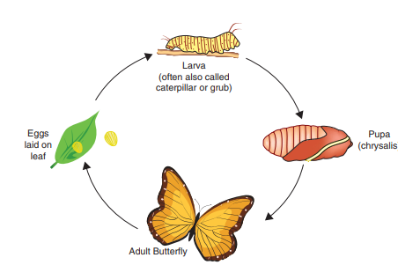
Insects and mites can be pests of plants by feeding on the plant as a source of nutrition,
Army worm
Fruit fly

Slide 18
Insects of economic importance
Common insects of crops:
Aphids
Thrips
Spider mites

Slide 19
Beneficial fungi
Saprophytes : These recycle nutrients able to break down complex organic material and release valuable elements including nitrogen, carbon and sulphur
Fungi are very important in the carbon cycle
Biotechnology : brewing and baking
Weed control : Some fungi attack weeds including wild oats and cleavers

